Slide 1





E-RENTING SYSTEM
Aamir Hussain

Slide 2
Objective
The objective of this project entitled “Renting System” is to provide a user- friendly and easily understandable GUI to manage the details of car, booking, and car status. It manages all the information about the Car Owner, customer, and cars.

Slide 3
Introduction
“E-RENTING SYSTEM”, is a car
renting and car listing projects. This web application helps users to individually rent cars and assists you in finding the perfect renting car.

Slide 4


Hardware and Software Specification
Technology: MEAN STACK
IDE: Visual studio code
Client-Side Technologies: HTML, SCSS, Typescript, Angular, Angular Material
Server-Side Technologies: Node js
DataBase Server: MongoDB
Operating System: Microsoft window

Slide 5
MEAN Stack
The MEAN stack is JavaScript- based framework for developing web applications. MEAN is named after Mongo DB, Express, Angular, and Node, the four key technologies that make up the layers of the stack.
Mongo DB - document database
Express js - Node.js web framework
Angular 12 - a client-side framework
Node js - the premier JavaScript
web server

Slide 6

Working
Shows the information and description of the car, owner, and customer.
Tracks all the information of rent, booking, and owner.
Manage the information about the Car.
Manage the information of the car Owner.
Manage the information of the customer.

Slide 7

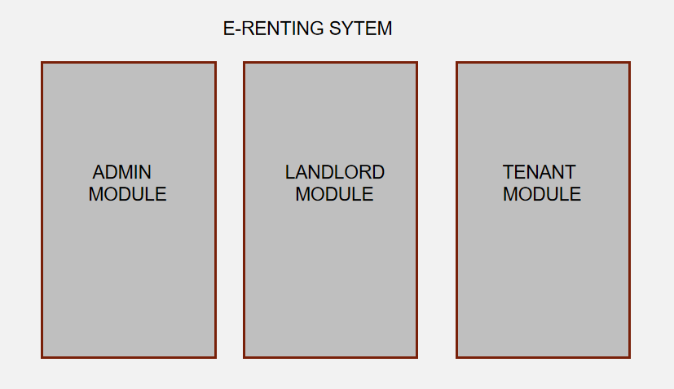
ADMIN MODULE
CAR OWNER MODULE
CUSTOMER MODULE

Slide 8
Admin Modules
Manage(Add/View/Edit/Delete) Car Owner.
Manage(View/Delete)Customer.
Manage(View/Delete)Car Details.
Change password.

Slide 9
Car OwnerModules
View Customer and car Details.
Approve and reject customer requests for a car.
Change password.
Upload car information.

Slide 10

Customer Modules
View car Information.
Book cars.
Change password.

Slide 11

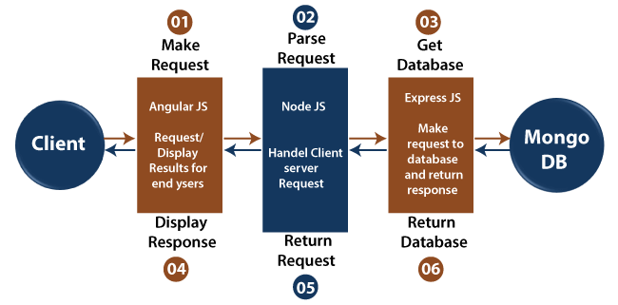
Architecture of Mean Stack

Slide 12

Purpose
There is always a need for a system that will provide online booking at home and also provides a facility for car owners to post information about their rooms online.
The system will override the problems prevailing in the practicing manual system. This software is supported to eliminate in some cases the hardships faced by this existing system.

Slide 13
Scope for future enhancement
We can add GPS system in future.
We can also give live chat online option to users.
Better customer service. (24x7)

Slide 14
Conclusion
This project has several advantages. Managing the levels of the projects is pretty easy and so is storing the details of the car, car owner, and customer. It is easy to maintain up-to-date information and is cheaper to maintain. Also, manual tracking is not required.

Slide 15

THANK YOU!

